Slide 1
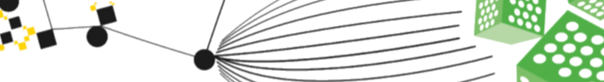

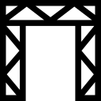
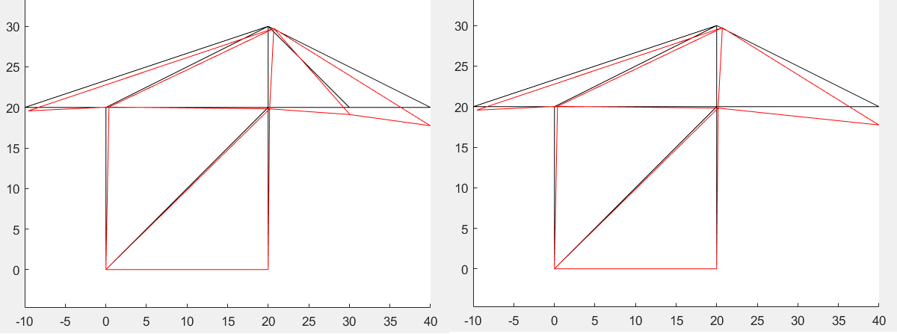

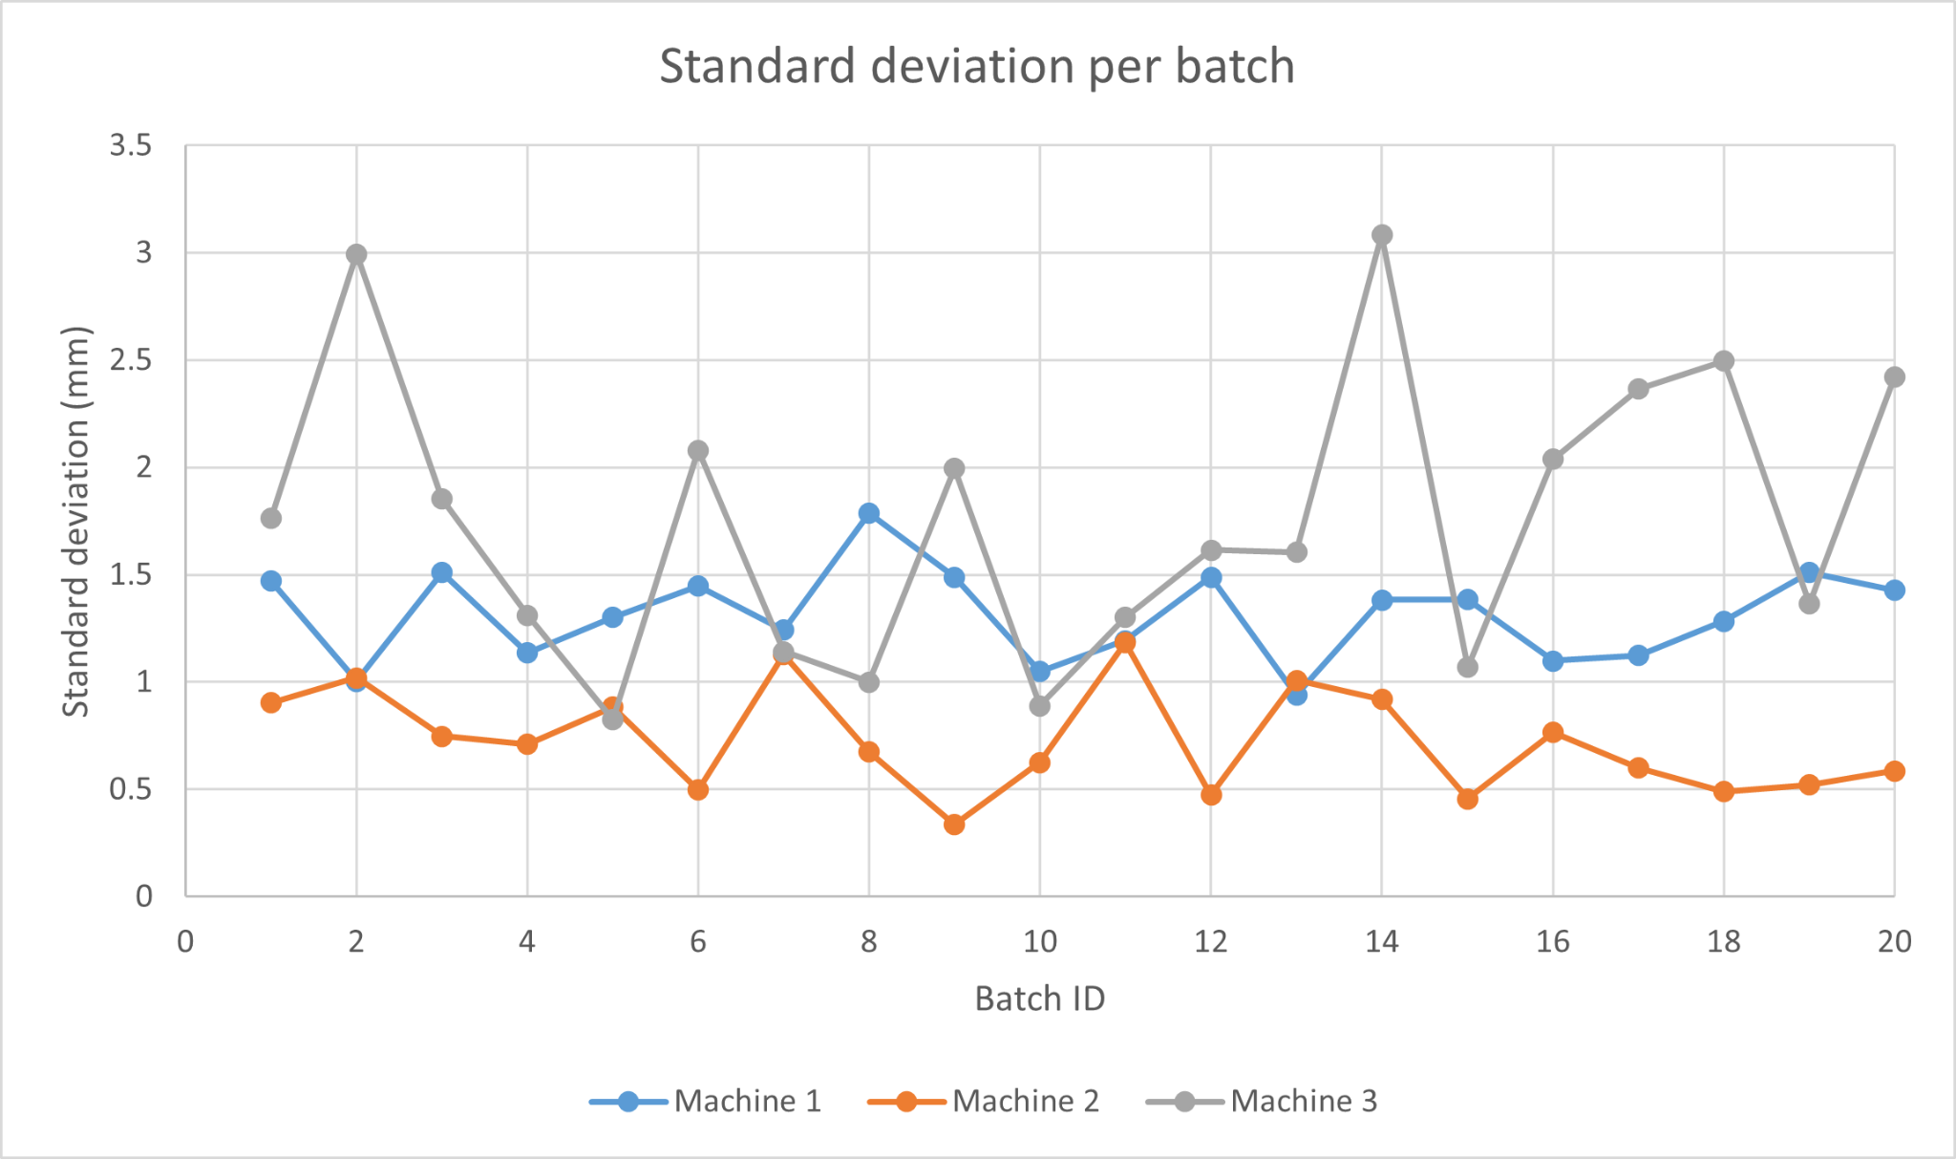

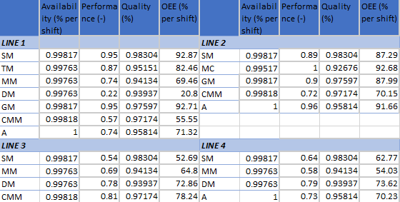
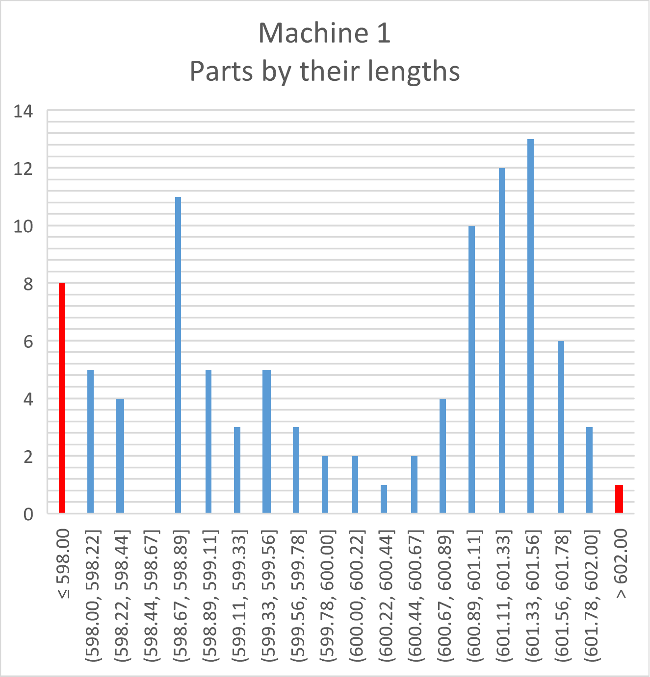
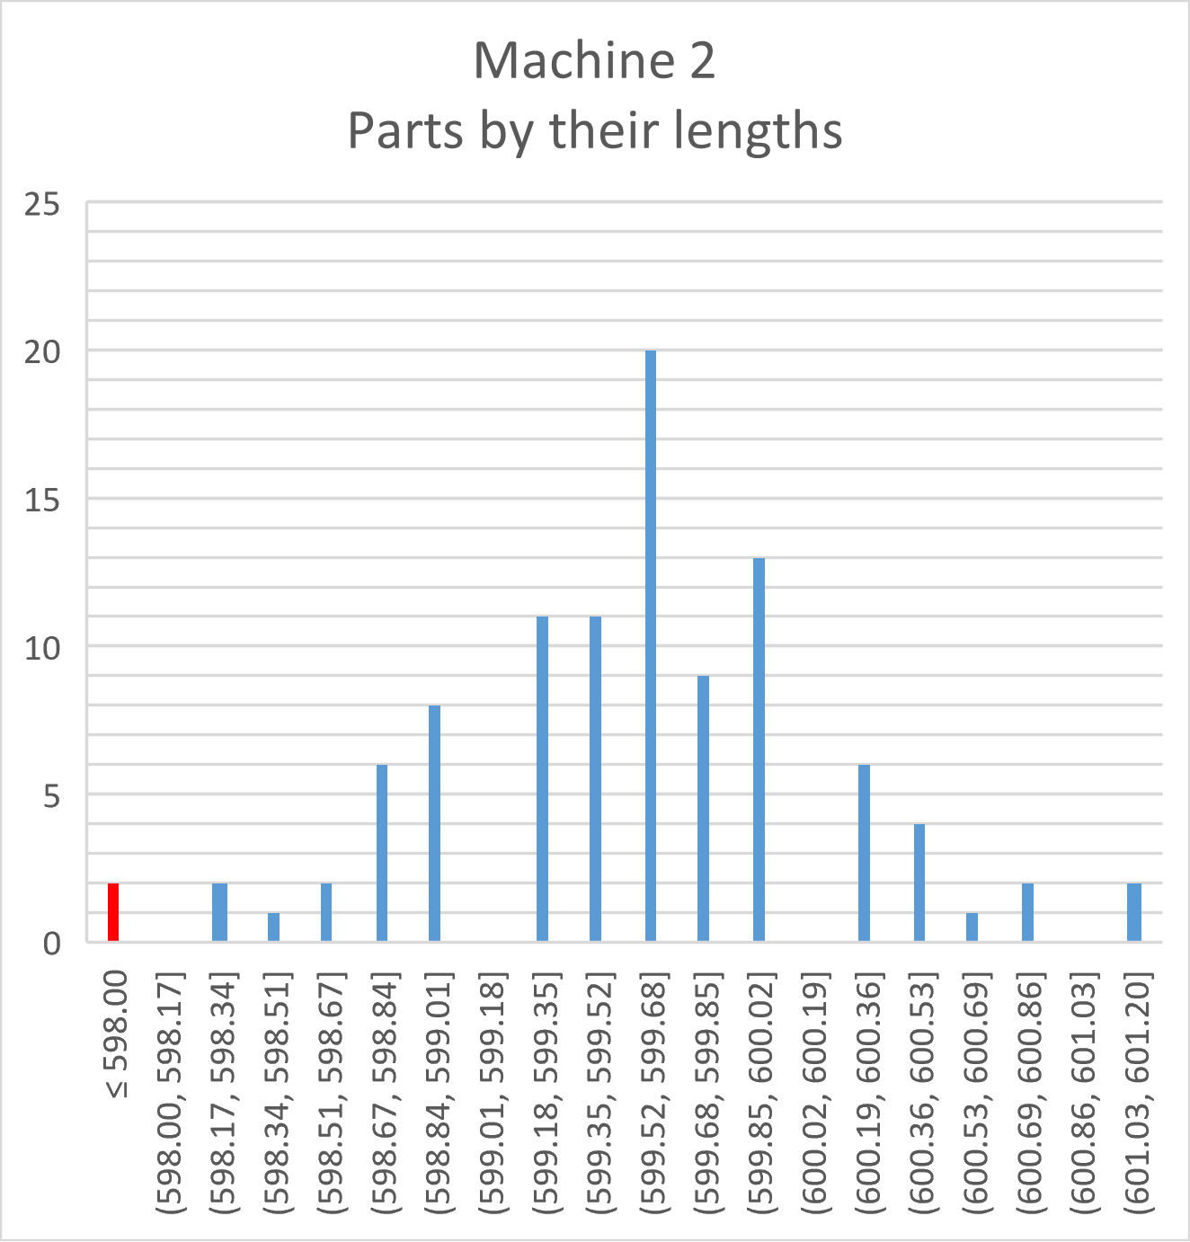
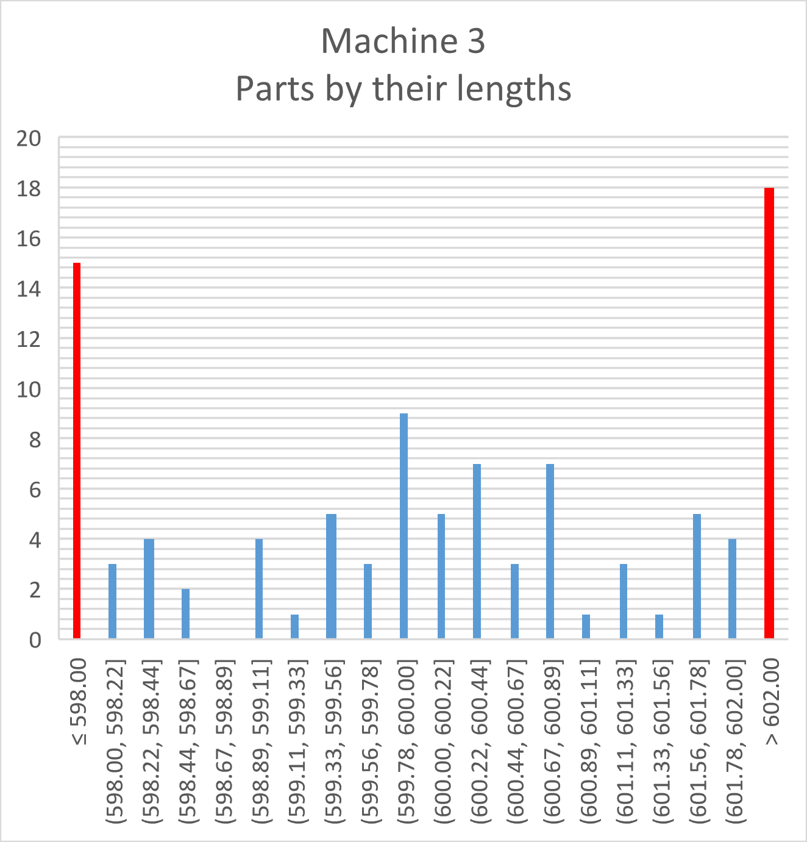

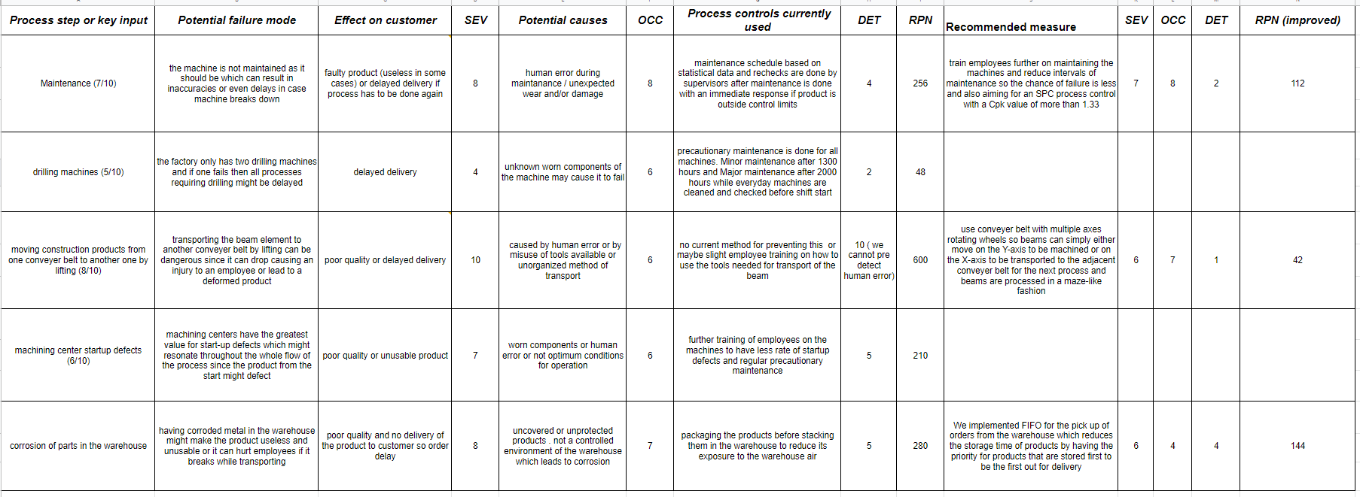
Quality Control & Risk Mitigation
Martijn Bos
Jaap Janssen
Youssef Kamel
Group 2
Subsystem Requirements
FEM Analysis
Priority performance parameters:
Quality (being right)
Dependability (delivery on time)
From the 5 performance parameters we decided to prioritize these parameters over the others. This is based on Etone’s preferences because customer satisfaction is of top priority to them. Based on that, the subsystem’s requirements are defined as follows.
Requirements:
Maintain quality standards of the product (Cpk-values > 1.5)
Maintain machinery (maintenance & defects, OEE > 90%)
Risk management
Our first requirement is analysing the quality of our product and maximize it for optimum customer satisfaction and enhancing production reputation of Etone. This requirement is fulfilled under section Quality Control. As for the second requirement, which is slightly dependent on the first one which focuses on optimizing a maintenance schedule in order to maintain the quality target set for our products, this requirement is discussed further under section Maintenance Strategy. For the third requirement we analyze risks in our system in the form of an FMEA analysis, this is shown in section FMEA analysis. At last an FEM analysis was performed to determine if any elements could be eliminated.
In the figure above the undeformed (black) and deformed (red) frames of the original structure (left) and the modified version without element 13 (right) are displayed.With the help of ANSYS [1], the deformations at the boom tip were found, see table below. The maximum allowed displacement at the tip of 4mm is not reached, so element 13 can be safely removed. Also the highest stress in the structure does not exceed the materials yield stress. We also tried removing element 12, but the deformations were not acceptable.
Quality Control
A quality analysis has been performed on the three lates with the data that was provided. The graphs below show the Standard Deviation, Cpk- & Cp-values, as well as the amount of parts with their length, for all three machines.
 | Possible crane setup
Properties | Complete crane | Removing element 12 | Removing element 13
Deformation at the tip [mm] (x-direction) | -2.00 | -36.56 | -2.00
Deformation at the tip [mm] (y-direction) | -225.63 | -3.58e+16 | -225.63
Highest occurring Stress [MPa] | 232.92 | 218.54 | 232.92
 | Efficiency (%) | σ_{AVERAGE} (mm) | C_{p} (-) | C_{pk} (-)
Machine 1 | 95 | 1.31 | 0.57 | 0.55
Machine 2 | 99 | 0.73 | 1.14 | 0.88
Machine 3 | 71 | 1.76 | 0.42 | 0.37
Maintenance Strategy
Based on quality control on the lathes, less time between preventive maintenance may be needed to achieve lower scrap rates and thus a higher quality rate. Another option is to use smart maintenance equipment to achieve optimal maintenance schedules. For now we stick to a time based maintenance of 1300 and 3900 hours for minor and major preventive maintenance respectively.
FMEA Analysis [2]
Conclusion
References: [1] ANSYS (https://www.ansys.com/)
[2] FMEA (Failure Mode and Effects Analysis) Quick Guide", iSixSigma, 2022. [Online]
The achieved OEE is too low for most machinegroups in each production line, however there are some good things, such as a robust factory, availability for further expansion of the factory. Ways to improve the OEE could be to share certain machines between two different production lines.
By looking at the quality analysis (Cpk & Cp), one can conclude that maintenance should be done more often, perhaps by using a maintenance 4.0 approach.
After doing the FEM analysis, it is concluded that element 13 can be removed without any extra unwanted displacement.
UNIVERSITY OF TWENTE.

